Slide 1
Seasonal Outlook
Elizabeth Padian

Slide 2
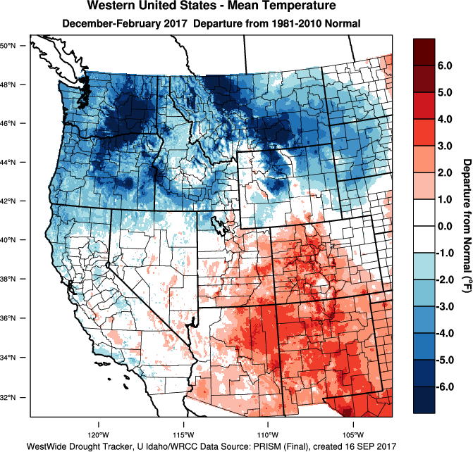
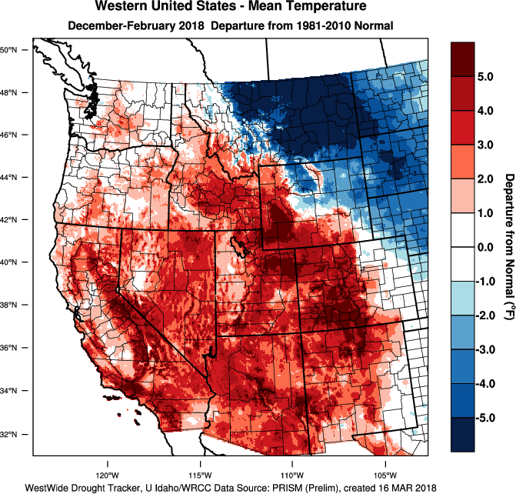

Slide 3
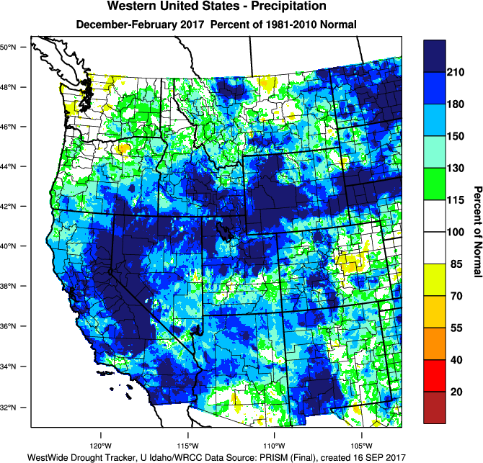
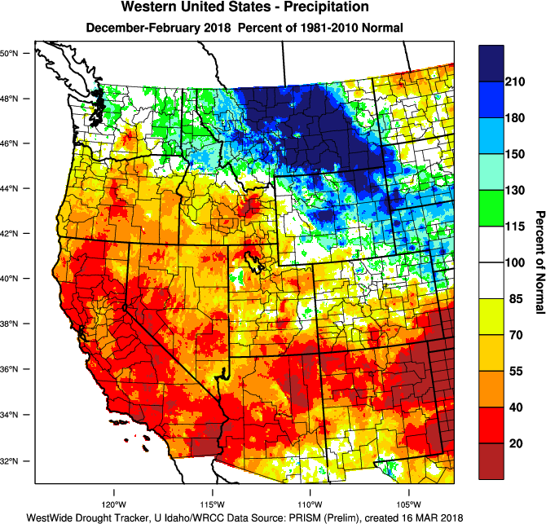

Slide 4
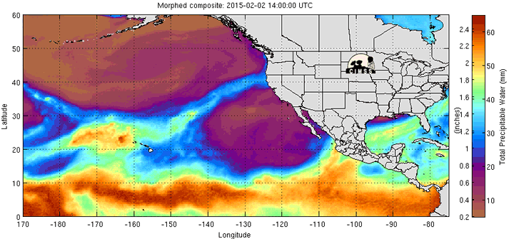
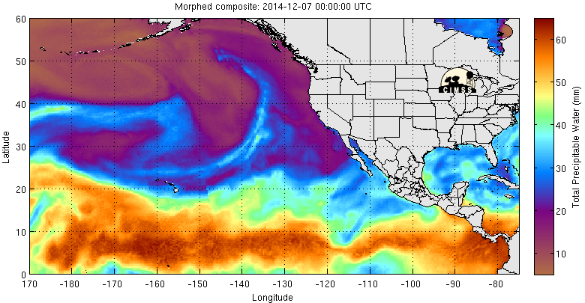

Slide 5
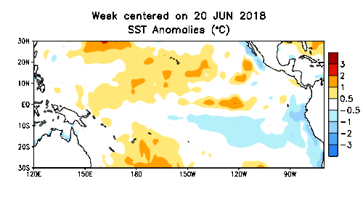
Currently: ENSO Neutral
NH Fall 2018: 60% chance of El Nino
NH Winter 2018-2019: 70% chance of El Nino

Slide 6
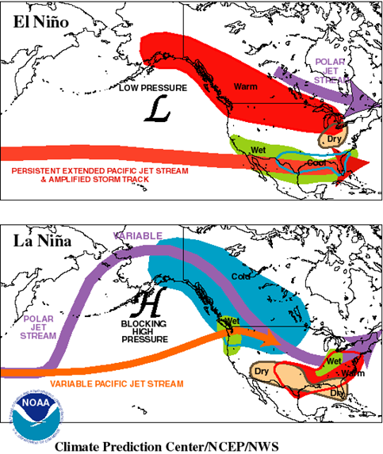

Slide 7
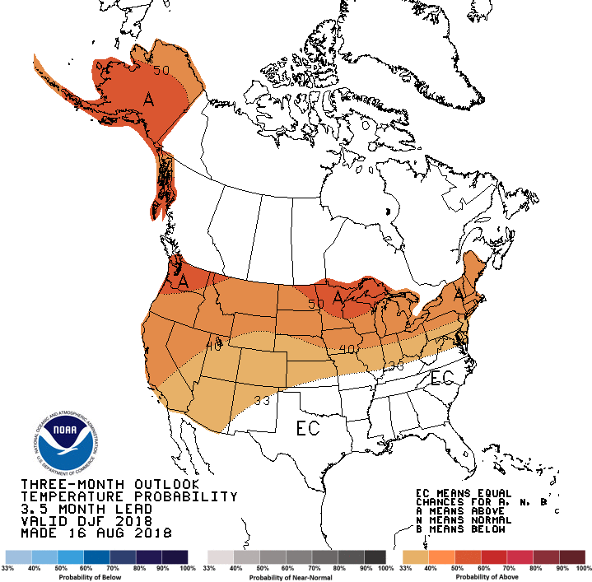

Slide 8
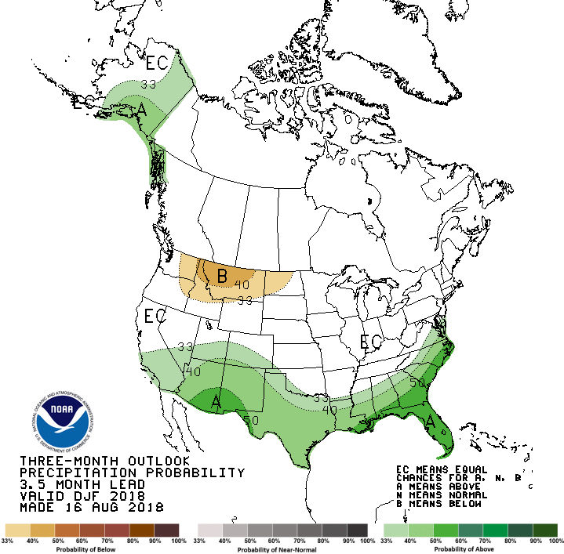

Slide 9
Elizabeth Padian
NWS WFO Boise
208-334-9860

